Slide 1
Dump Analysis & Tips
Sean Yen

Slide 2
Outline
Windows Memory Layout
Different Dump Types
Debug Symbol
Call Stack
“!Analyze –v”

Slide 3
Windows Memory Layout
Process 3
0x00000000
Process 2
Process 1
HD
0x7FFFFFFF
Page Fault
0x8000000
Session Space
0xFFFFFFFF
Virtual memory

Slide 4
Different Dump Types

Slide 5
Different Dump Types
Notepad.dmp
Notepad
Calc.dmp
Calc
ntosknl
Full Memory Dump
Kernel Memory dump
Physical memory

Slide 6
Different Dump Types
Complete memory dump
Kernel memory dump
Small memory dump (64 KB)
The Stop message and its parameters and other data
loaded drivers
The processor context (PRCB) for the processor that stopped
The process information and kernel context (EPROCESS) for the process that stopped
The process information and kernel context (ETHREAD) for the thread that stopped
The Kernel-mode call stack for the thread that stopped

Slide 7
Different Dump Types
Minidump
A user-mode dump file that includes only selected parts of the memory associated with a process is called a minidump.
Full user dump
entire memory space of a process, the program's executable image itself, the handle table, and other information that will be useful to the debugger.

Slide 8
Common Dump Types
When people are asking a dump, it usually means…
Full user-mode dump
Complete memory dump

Slide 9
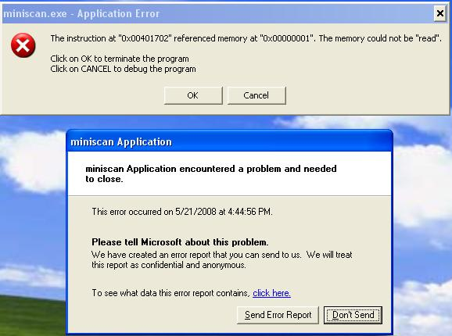
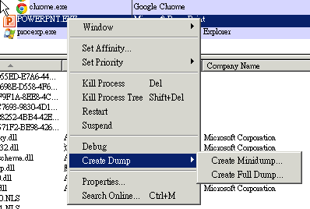
Tips for Mini/Full Dump
Don’t close application error dialog
Use Process Explorer

Slide 10
Tips for AMSP Mini/Full Dump
Disable Self-Protection
Add Debugger into Exclusion List.
Otherwise, debugger & AMSP will deadlock the OS.
AMSP_ClientLibrary_MT.exe -c=add_exclusion_pid -id=<PID>

Slide 11
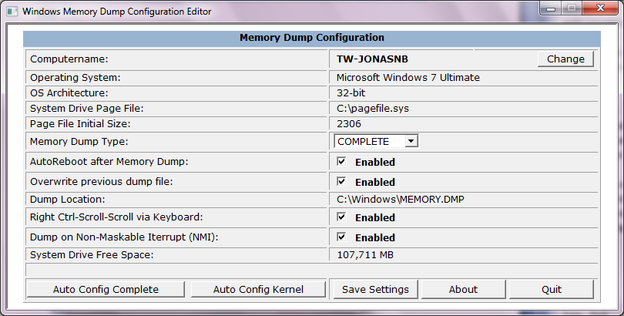
Tips for Memory Dump
Use DumpConfiguration tool
Once options are decided, click “Auto Config Complete”.

Slide 12
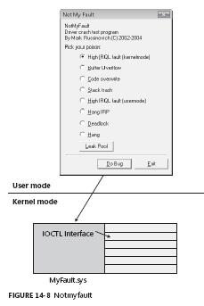
Tips for Memory Dump
If “Right Ctrl-Scroll-Scroll via Keyboard” is enabled, then you can click the keystroke sequence anytime to generate memory dump.
USB Keyboard requires hotfix to use the feature.
Some note book cannot use this feature due to no scroll key.

Slide 13
Debug Symbol

Slide 14
Symbol
Memory is just sequences of raw bytes
Symbols help the debugger to :
Map raw addresses to source code lines
Analyze internal layout and data of applications and OS.

Slide 15
Symbol
Public functions and variables
FPO information
Private functions and variables (X)
Source file and line information (X)
Type information (X)
Generate a PDB file (/DEBUG, /Z7, /Zd, or /Zi)
The /PDBSTRIPPED option creates a second program database (PDB)
This second PDB file omits symbols that you would not want to ship to your customers.
Public Symbols for MS modules (kernel32.dll, user32.dll…) are always stripped.

Slide 16
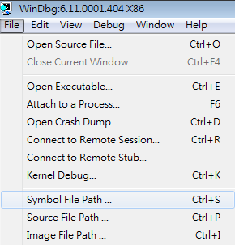
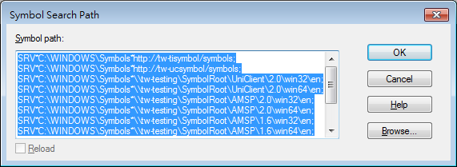
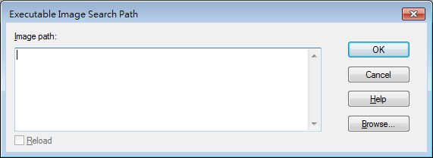
How to Setup Symbol & Image Path

Slide 17
Tips for Symbol Path
Useful Symbol Server
SRV*C:\WINDOWS\Symbols*\\tw-testing\SymbolRoot\UniClient\2.0\win32\en;
SRV*C:\WINDOWS\Symbols*\\tw-testing\SymbolRoot\UniClient\2.0\win64\en;
SRV*C:\WINDOWS\Symbols*\\tw-testing\SymbolRoot\UniClient\1.6\win32\en;
SRV*C:\WINDOWS\Symbols*\\tw-testing\SymbolRoot\UniClient\1.6\win64\en;
SRV*C:\WINDOWS\Symbols*\\tw-testing\SymbolRoot\UniClient\1.5\win32\en;
SRV*C:\WINDOWS\Symbols*\\tw-testing\SymbolRoot\UniClient\1.5\win64\en;
SRV*C:\WINDOWS\Symbols*\\tw-testing\SymbolRoot\AMSP\2.0\win32\en;
SRV*C:\WINDOWS\Symbols*\\tw-testing\SymbolRoot\AMSP\2.0\win64\en;
SRV*C:\WINDOWS\Symbols*\\tw-testing\SymbolRoot\AMSP\1.6\win32\en;
SRV*C:\WINDOWS\Symbols*\\tw-testing\SymbolRoot\AMSP\1.6\win64\en;
SRV*C:\WINDOWS\Symbols*http://tw-amspsymbol/AMSP;
SRV*C:\WINDOWS\Symbols*http://tw-coretech:81/symbols/;
SRV*C:\WINDOWS\Symbols*http://tw-amspsymbol/WINDOWS;
SRV*C:\WINDOWS\Symbols*http://msdl.microsoft.com/download/symbols
Archived Debug Symbol
\\tw-testing\Archive\Uniclient\win32\v1.6\en\1101_GM\debug_symbol
\\tw-testing\Archive\Uniclient\win64\v1.6\en\1101_GM\debug_symbol

Slide 18
Tip for Reload Symbol
List Loaded Module “lm”
Force to load symbol
“.reload /r /i advapi32.dll=77d80000,A9000”
“/r” means to reload if loaded
“/i” means to ignore checksum
“xxx.dll=<start address>,<image size>”
0:000> lm
start end module name
…
77cf0000 77d80000 user32 (pdb symbols) c:\windows\symbols\user32.pdb\D18A41B74E7F458CAAAC1847E2D8BF022\user32.pdb
77d80000 77e29000 advapi32 (deferred)
77e30000 77ec3000 rpcrt4 (deferred)
77ed0000 77f19000 gdi32 (deferred)
77f20000 77f96000 shlwapi (deferred)
77fa0000 77fb1000 secur32 (deferred)
77fc0000 77ff2000 activeds (deferred)
78130000 781cb000 msvcr80 (deferred)
782e0000 783ef000 mfc80u (deferred)
7c420000 7c4a7000 msvcp80 (deferred)
7c800000 7c933000 kernel32 (deferred)
7c940000 7c9df000 ntdll (pdb symbols) c:\windows\symbols\ntdll.pdb\CEFC0863B1F84130A11E0F54180CD21A2\ntdll.pdb
7d5b0000 7ddb0000 shell32 (deferred)
7e8c0000 7e971000 userenv (deferred)

Slide 19
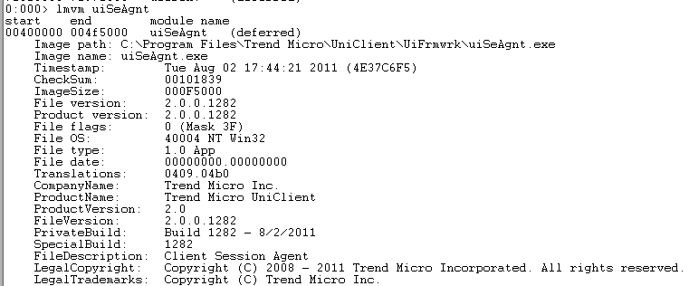
Tips for Check Binary Version
“lm”
To list all loaded module
“lmvm <module name>”
To show module information

Slide 20
Call Stack

Slide 21
Call Stack
A chain of function call which leads to current execution point.
Multi-thread program could have multiple call stacks at the same time.
Why important?
Call stack helps us identify which function lead to a crash.
Call stacks also helps us identify which function blocks the execution. → important for hang issue.

Slide 22
How to Watch Call Stack for A Thread
Identify which thread you are.
Switch current thread if needed.
Type “~<thread no.>s” to switch
E.g., “~2s” means to switch to thread no.2
Watch call stack
Type “kvn” to watch
“WARNING” as below means some debug symbol is missing. Find correct symbol first.
0:000> kvn
# ChildEBP RetAddr Args to Child
00 0012fec4 77cf91be 77cf91f1 001554b0 00000000 ntdll!KiFastSystemCallRet (FPO: [0,0,0])
01 0012fee4 783482a9 001554b0 00000000 00000000 user32!NtUserGetMessage+0xc
WARNING: Stack unwind information not available. Following frames may be wrong.
02 00000000 00000000 00000000 00000000 00000000 mfc80u+0x682a9

Slide 23
How to Watch All Call Stacks
“~*k”
This command is to show all call stacks at once.
0:000> ~*k
. 0 Id: d9c.8f4 Suspend: 0 Teb: 7ffdd000 Unfrozen
ChildEBP RetAddr
0012fec4 77cf91be ntdll!KiFastSystemCallRet
0012fee4 783482a9 user32!NtUserGetMessage+0xc
WARNING: Stack unwind information not available. Following frames may be wrong.
00000000 00000000 mfc80u+0x682a9
1 Id: d9c.a88 Suspend: 0 Teb: 7ffdc000 Unfrozen
ChildEBP RetAddr
013cfe60 7c94df4a ntdll!KiFastSystemCallRet
013cfe64 7c809590 ntdll!ZwWaitForMultipleObjects+0xc
013cff00 7c80a115 kernel32!WaitForMultipleObjectsEx+0x12c
013cff1c 60eb1d51 kernel32!WaitForMultipleObjects+0x18
*** ERROR: Symbol file could not be found. Defaulted to export symbols for msvcr80.dll -
013cff74 781329bb utilDebugLog!MonitorThread+0xb1 [d:\amsp_2.0\src\framework\utility\utildebuglog\util_defaultlogwriter.cpp @ 81]
WARNING: Stack unwind information not available. Following frames may be wrong.
013cffac 78132a47 msvcr80!endthreadex+0x3b
013cffec 00000000 msvcr80!endthreadex+0xc7
2 Id: d9c.17d0 Suspend: 0 Teb: 7ffdb000 Unfrozen
ChildEBP RetAddr
016bfb70 7c94df4a ntdll!KiFastSystemCallRet
016bfb74 7c809590 ntdll!ZwWaitForMultipleObjects+0xc
016bfc10 7c80a115 kernel32!WaitForMultipleObjectsEx+0x12c
016bfc2c 00403a6f kernel32!WaitForMultipleObjects+0x18
016bfe34 004043a3 uiSeAgnt!waitForStop+0x7f [d:\uniclient_2.0_win32\src\uiframework\uiseagnt\amspclientmanager.cpp @ 507]
016bffb4 7c80b729 uiSeAgnt!amspConnectFunc+0x3e3 [d:\uniclient_2.0_win32\src\uiframework\uiseagnt\amspclientmanager.cpp @ 576]
016bffec 00000000 kernel32!BaseThreadStart+0x37
…

Slide 24
How to Watch Call Stack in Memory Dump
“!PROCESS 0 0”
To list all processes
“!PROCESS 0 7”
To list all processes with kernel call stack
How to see call stacks for one process
“!PROCESS 0 0”
“.PROCESS xxxxxxxx”
“.RELOAD”
“!PROCESS xxxxxxxx 7”

Slide 25
More on Call Stack
However, it’s inefficient to read every call stack one by one to find the problem.
Luckily, WinDbg provides a wizard command to automate dump analysis.

Slide 26
!Analyze -v

Slide 27
A Result from !Anayze –v
0:003> !analyze -v
*******************************************************************************
* *
* Exception Analysis *
* *
*******************************************************************************
FAULTING_IP:
ntdll!RtlpWaitOnCriticalSection+ba
00000000`776ff7fa 83402401 add dword ptr [rax+24h],1
EXCEPTION_RECORD: ffffffffffffffff -- (.exr 0xffffffffffffffff)
ExceptionAddress: 00000000776ff7fa (ntdll!RtlpWaitOnCriticalSection+0x00000000000000ba)
ExceptionCode: c0000005 (Access violation)
ExceptionFlags: 00000000
NumberParameters: 2
Parameter[0]: 0000000000000001
Parameter[1]: 0000000000000024
Attempt to write to address 0000000000000024
PROCESS_NAME: coreServiceShell.exe
ERROR_CODE: (NTSTATUS) 0xc0000005 - The instruction at 0x%08lx referenced memory at 0x%08lx. The memory could not be %s.
EXCEPTION_CODE: (NTSTATUS) 0xc0000005 - The instruction at 0x%08lx referenced memory at 0x%08lx. The memory could not be %s.
EXCEPTION_PARAMETER1: 0000000000000001
EXCEPTION_PARAMETER2: 0000000000000024
WRITE_ADDRESS: 0000000000000024
FOLLOWUP_IP:
tmncieco!TM_NS_PurgeOldPatternW+375 [d:\ncie_1.0\src\wrapper\minitda\coordinator\coordinator.cpp @ 992]
000007fe`fbe42b95 488b5c2468 mov rbx,qword ptr [rsp+68h]
NTGLOBALFLAG: 0
APPLICATION_VERIFIER_FLAGS: 0
FAULTING_THREAD: 0000000000000e20

Slide 28
A Result from !Anayze –v
BUGCHECK_STR: APPLICATION_FAULT_NULL_CLASS_PTR_DEREFERENCE_INVALID_POINTER_WRITE
PRIMARY_PROBLEM_CLASS: NULL_CLASS_PTR_DEREFERENCE
DEFAULT_BUCKET_ID: NULL_CLASS_PTR_DEREFERENCE
LAST_CONTROL_TRANSFER: from 00000000776ff718 to 00000000776ff7fa
STACK_TEXT:
00000000`02e9db70 00000000`776ff718 : ffffffff`00000000 00000000`00000000 00000000`2bc4d904 00000000`003cbb10 : ntdll!RtlpWaitOnCriticalSection+0xba
00000000`02e9dc20 00000000`775c5e16 : 00000000`003cbaf0 00000000`00000003 00000000`003cbaf0 00000000`00000003 : ntdll!RtlEnterCriticalSection+0xf4
00000000`02e9dc50 000007fe`fbe42b95 : 00000000`003f10b0 00000000`00000000 00000000`00000003 00000000`04eebba8 : kernel32!FindClose+0x36
00000000`02e9dc80 000007fe`fbe43575 : 00000000`2bacc620 00000000`2bacc648 00000000`02e9dfe0 00000000`2bacc620 : tmncieco!TM_NS_PurgeOldPatternW+0x375 [d:\ncie_1.0\src\wrapper\minitda\coordinator\coordinator.cpp @ 992]
00000000`02e9dfb0 000007fe`f888a2a4 : 00000000`000008ac 00000000`00000000 00000000`00000000 00000000`04d9f1c0 : tmncieco!tm_ncieco_LoadScanPattern+0x415 [d:\ncie_1.0\src\wrapper\minitda\coordinator\coordinator.cpp @ 1113]
00000000`02e9e0d0 000007fe`f8881836 : 00000000`20ff0000 00000000`00000048 00000000`02e9e1b0 00000000`00000000 : plugAdapterNCIE!CNcieAdapter::Init+0x274 [d:\ncie_1.0\src\wrapper\minitda\adapter\ncieadapter.cpp @ 363]
00000000`02e9e170 00000000`60232f0f : 00000000`02e9e6f8 00000000`022fabe8 00000000`022f9380 00000000`60274eae : plugAdapterNCIE!Plugin_Interface_PostInitialize+0x1c6 [d:\ncie_1.0\src\wrapper\minitda\adapter\adapter.cpp @ 90]
00000000`02e9e230 00000000`60224827 : 00000000`00000000 00000000`00009748 00000000`00000067 000001f9`00f20001 : coreFrameworkBuilder!CPluginInterfaceOrganizer::SwitchInterface+0x2a2f [d:\amsp_2.0\src\framework\utility\utilcommonplugin\plugininterfaceorganizer.cpp @ 1232]
00000000`02e9f560 00000000`602234ea : 00000000`60221120 00000000`20ff0000 00000000`026c1fe0 00000000`20ff0000 : coreFrameworkBuilder!CFrameworkBuilder::InitAsDetectionMode+0x1197 [d:\amsp_2.0\src\framework\core\coreframeworkbuilder\frameworkbuilder.cpp @ 439]
00000000`02e9fb10 00000001`400050ee : 00000000`000001ac 00000000`000001ac 00000000`e0ff0005 00000000`60221120 : coreFrameworkBuilder!CFrameworkBuilder::OnNotify+0xda [d:\amsp_2.0\src\framework\core\coreframeworkbuilder\frameworkbuilder.cpp @ 234]
00000000`02e9fb90 00000001`40008d4c : 00000000`00000052 00000001`4002f950 00000000`00000000 00000001`4002f950 : coreServiceShell!InitFramework+0x7de [d:\amsp_2.0\src\framework\core\coreserviceshell\service_main.cpp @ 627]
00000000`02e9fd40 00000000`74ce37d7 : 00000000`026c3ab0 00000000`00000000 00000000`00000000 00000000`00000000 : coreServiceShell!CreateFramework+0xb1c [d:\amsp_2.0\src\framework\core\coreserviceshell\service_main.cpp @ 1422]
00000000`02e9ff00 00000000`74ce3894 : 00000000`74d995c0 00000000`026c3ab0 00000000`00000000 00000000`00000000 : msvcr80!_callthreadstartex+0x17 [f:\dd\vctools\crt_bld\self_64_amd64\crt\src\threadex.c @ 348]
00000000`02e9ff30 00000000`775d495d : 00000000`00000000 00000000`00000000 00000000`00000000 00000000`00000000 : msvcr80!_threadstartex+0x84 [f:\dd\vctools\crt_bld\self_64_amd64\crt\src\threadex.c @ 326]
00000000`02e9ff60 00000000`77708791 : 00000000`00000000 00000000`00000000 00000000`00000000 00000000`00000000 : kernel32!BaseThreadInitThunk+0xd
00000000`02e9ff90 00000000`00000000 : 00000000`00000000 00000000`00000000 00000000`00000000 00000000`00000000 : ntdll!RtlUserThreadStart+0x1d
STACK_COMMAND: kb
FAULTING_SOURCE_CODE:
No source found for 'd:\ncie_1.0\src\wrapper\minitda\coordinator\coordinator.cpp'
SYMBOL_STACK_INDEX: 3
SYMBOL_NAME: tmncieco!TM_NS_PurgeOldPatternW+375
FOLLOWUP_NAME: MachineOwner
MODULE_NAME: tmncieco
IMAGE_NAME: tmncieco.dll
DEBUG_FLR_IMAGE_TIMESTAMP: 4dd11a26
FAILURE_BUCKET_ID: NULL_CLASS_PTR_DEREFERENCE_c0000005_tmncieco.dll!TM_NS_PurgeOldPatternW
BUCKET_ID: X64_APPLICATION_FAULT_NULL_CLASS_PTR_DEREFERENCE_INVALID_POINTER_WRITE_tmncieco!TM_NS_PurgeOldPatternW+375
WATSON_STAGEONE_URL: http://watson.microsoft.com/StageOne/coreServiceShell_exe/2_0_0_1230/4de8fdb2/ntdll_dll/6_0_6001_18000/4791adec/c0000005/0001f7fa.htm?Retriage=1
Followup: MachineOwner
---------

Slide 29
Something Before Analysis
Understand the issue first.
From a crash?
From a hang?
Better to know the full story before analyzing.
It’s not silver bullet.
Better to have debug log to help you interpret the dump analysis.

Slide 30
How to Read Analysis Report
Find ExceptionCode first.
Common ExceptionCode
80000003 (Break instruction exception)
The dump is created manually.
You should analyze the call stack by yourself.
c0000005 (Access violation)
The dump is created from a crash.
ExceptionAddress: 00000000776ff7fa (ntdll!RtlpWaitOnCriticalSection+0x00000000000000ba)
ExceptionCode: c0000005 (Access violation)
ExceptionFlags: 00000000
NumberParameters: 2
Parameter[0]: 0000000000000001
Parameter[1]: 0000000000000024
Attempt to write to address 0000000000000024

Slide 31
How to Read Analysis Report
Call Stack
From top to down, identify the first module belong to us.
Then, pass this report to the module owner.
ntdll!RtlpWaitOnCriticalSection+0xba
ntdll!RtlEnterCriticalSection+0xf4
kernel32!FindClose+0x36
tmncieco!TM_NS_PurgeOldPatternW+0x375
tmncieco!tm_ncieco_LoadScanPattern+0x415
plugAdapterNCIE!CNcieAdapter::Init+0x274
plugAdapterNCIE!Plugin_Interface_PostInitialize+0x1c6
coreFrameworkBuilder!CPluginInterfaceOrganizer::SwitchInterface+0x2a2f
coreFrameworkBuilder!CFrameworkBuilder::InitAsDetectionMode+0x1197
coreFrameworkBuilder!CFrameworkBuilder::OnNotify+0xda
coreServiceShell!InitFramework+0x7de
coreServiceShell!CreateFramework+0xb1c
msvcr80!_callthreadstartex+0x17
msvcr80!_threadstartex+0x84
kernel32!BaseThreadInitThunk+0xd
ntdll!RtlUserThreadStart+0x1d

Slide 32
How to Read Analysis Report
Heap Corruption
It’s a special case
Don’t trust the call stack.
Enable page heap and appverifier to reproduce again.
ADDITIONAL_DEBUG_TEXT: Enable Pageheap/AutoVerifer
FAULTING_THREAD: 0000000000000d68
BUGCHECK_STR: APPLICATION_FAULT_HEAP_CORRUPTION_INVALID_POINTER_READ_FILL_PATTERN_ffffffff
PRIMARY_PROBLEM_CLASS: HEAP_CORRUPTION_FILL_PATTERN_ffffffff
DEFAULT_BUCKET_ID: HEAP_CORRUPTION_FILL_PATTERN_ffffffff

Slide 33
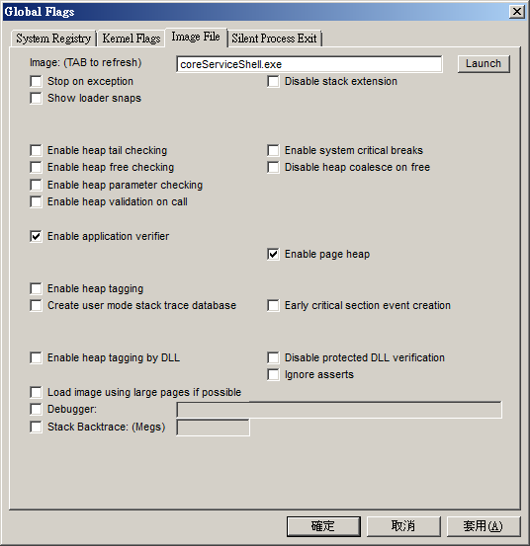
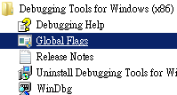
How to Enable Page Heap and App Verifier
Run Gflags.exe
Restart the Program

Slide 34
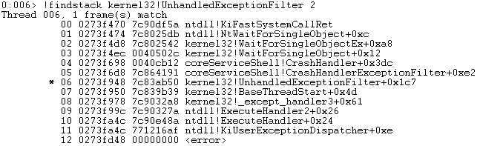
How to Read Analysis Report
What if 80000003 (Break instruction exception)?
Is hang issue?
So far there is no magic, use “~*k” to watch all call stacks.
Is crash issue?
Use “!findstack” to identify the crash point.
Abnormal Control Flow

Slide 35
Tips for WinDbg
Useful Information While Opening a Dump
“!peb”
Environment variables
DLL loaded list
DLL search path
Command Line
Windows XP Version 2600 (Service Pack 3) UP Free x86 compatible
Product: WinNt, suite: SingleUserTS
Machine Name:
Debug session time: Fri Aug 12 10:56:38.000 2011 (GMT+8)
System Uptime: 0 days 21:20:08.531
Process Uptime: 0 days 0:00:36.000

Slide 36
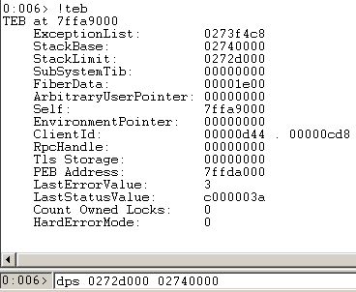
Tips for WinDbg
“!teb”
Thread stack address
Last error
Exception list
“dps”
To investigate raw data in thread stack
Useful for corrupted call stack or abnormal control flow
Require advanced knowledge for CPU calling convention.

Slide 37
Summary
Dump Type
Complete Memory Dump
Kernel Memory Dump
64-kb Memory Dump
Mini Dump
Full User-mode Dump
Debug Symbol
Call Stack
“!Analyze -v”

Slide 38
Reference
DumpConfiguration Tool
http://ishare.trendmicro.com/enggroup/ConPDG/ThinClient/Titanium%203.0/Shared%20Documents/Dev/!Getting%20Start/DumpAnalyze/WinPlatTools-14600.rar
Not My Fault
http://ishare.trendmicro.com/enggroup/ConPDG/ThinClient/Titanium%203.0/Shared%20Documents/Dev/!Getting%20Start/DumpAnalyze/Notmyfault.zip
Dump Training - AD1024
http://ishare.trendmicro.com/enggroup/ConPDG/ThinClient/Titanium%203.0/Shared%20Documents/Dev/!Getting%20Start/DumpAnalyze/AD1024%20Slide.rar

